Slide 1
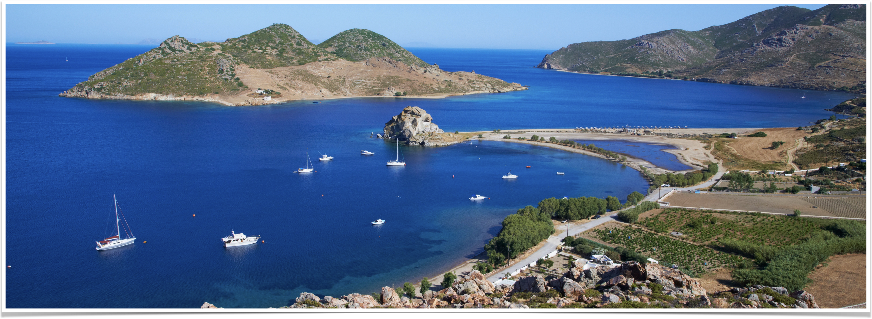
The Revelation of Jesus Christ
Vision 2 , Part 3 (6:9-7:17) - Seals 6 and 7

Slide 2
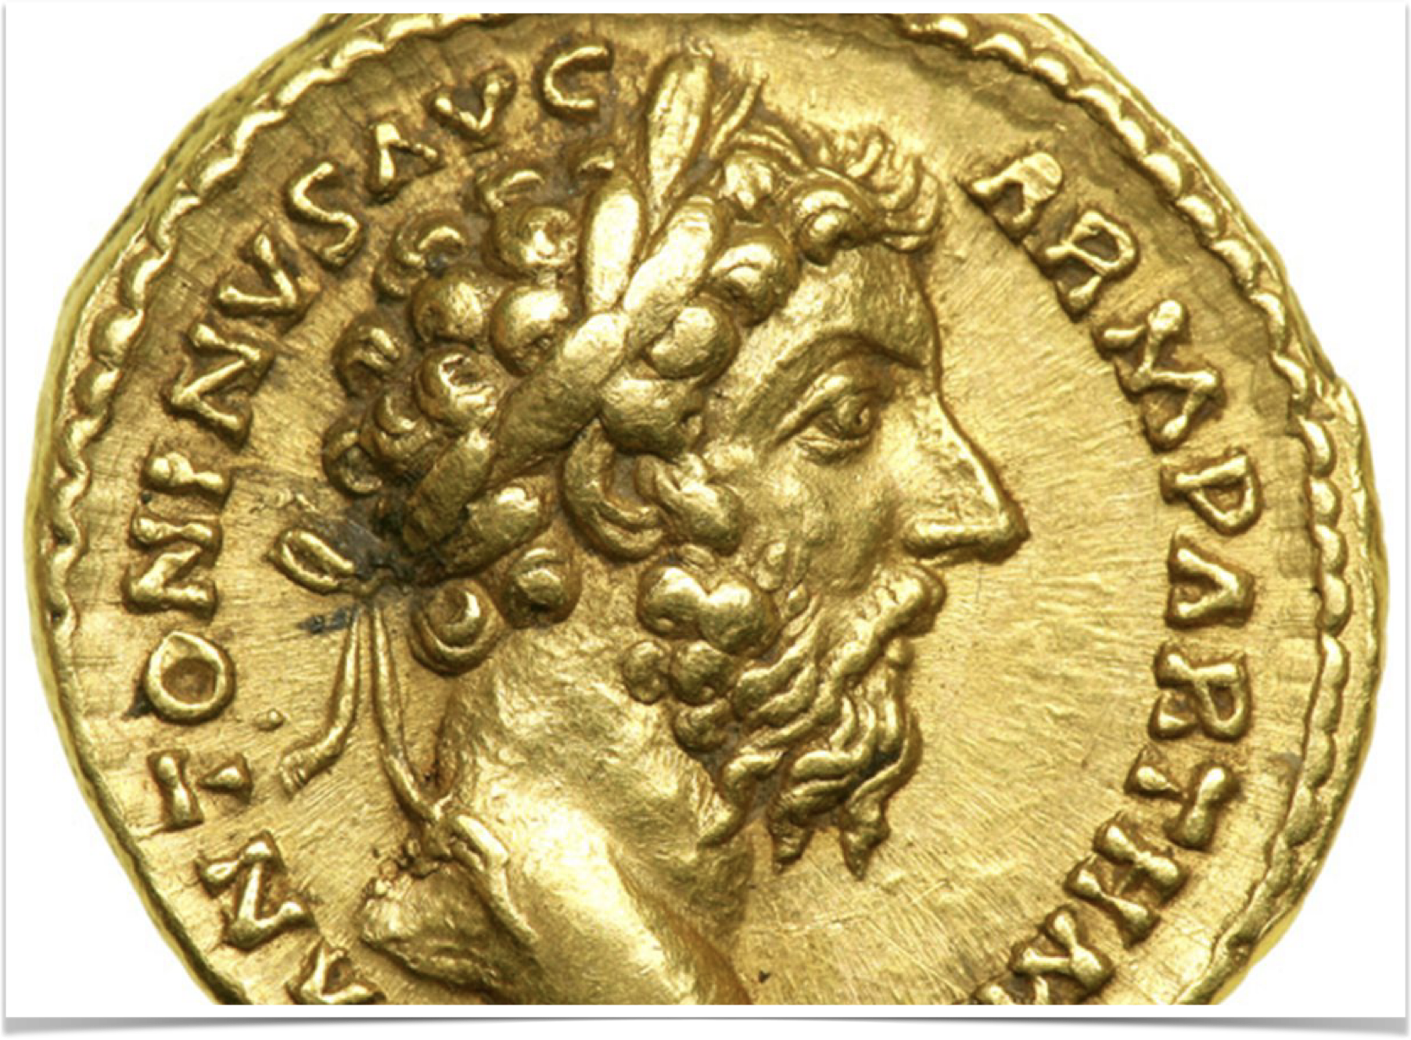
Seals 1-4 Review
Revelation in 96 toward the end of the reign of Domitian
Seal #1 - The Age of the Antonines (96-180 AD)
Seal #2 - Civil War (183-284 AD)
Seal #3 - Economic depression and famine (mid 200’s)
Seal #4 - Plague and War (250-265 AD)
Notes:
Revelation in 96 toward the end of the reign of Domitian
Seal #1 - The Age of the Antonines (96-180 AD)
Coin from Marcus Aurelius — notice the victor crown
Seal #2 - Civil War (183-284 AD)
Seal #3 - Economic depression and famine (mid 200’s)
Seal #4 - Plague and War (250-265 AD)

Slide 3
Seal #5 — the martyrs’ prayer
Notes:
Read Revelation 6:9-11

Slide 4
Seal #5 - What John Sees
“altar” - a symbol of sacrifice
“soul” - not a physical state; apparent consciousness following death
“white robe” - innocence and purity; given to the faithful
  4:4 - 24 elders are clothed in white robes
  Revelation 7:13-14, “Then one of the elders answered, saying to me, ‘Who are these arrayed in white robes, and where did they come from?’ [14] And I said to him, ‘Sir, you know.’ So he said to me, ‘These are the ones who come out of the great tribulation, and washed their robes and made them white in the blood of the Lamb.’”
Notes:
“altar” - a symbol of sacrifice
“soul” - not a physical state; apparent consciousness following death
“white robe” - innocence and purity; given to the faithful
4:4 - 24 elders are clothed in white robes
Revelation 7:13-14, “Then one of the elders answered, saying to me, ‘Who are these arrayed in white robes, and where did they come from?’ [14] And I said to him, ‘Sir, you know.’ So he said to me, ‘These are the ones who come out of the great tribulation, and washed their robes and made them white in the blood of the Lamb.’”

Slide 5
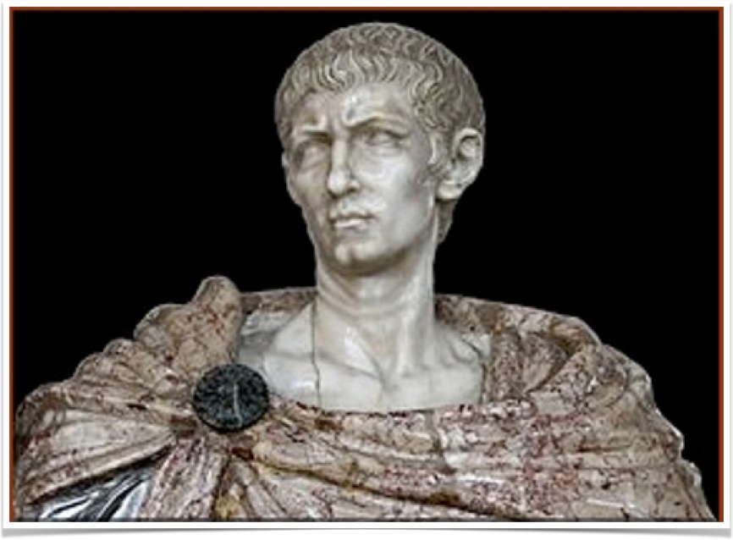
persecution of the church - 303-311
10 prominent persecutions under the Roman Caeasars
284 - Diocletian becomes emperor
303 - pushed by Galerius to stamp out the faith
303-311 was the most intense persecution
Notes:
10 prominent periods of persecution under the Roman Caesars
The first was instigated by Nero; Domitian followed suit, most famously banishing the Apostle John to Patmos.
During the time of Seal #1, the “Age of the Antonines,” Trajan and Marcus Aurelius persecuted Christians
Persecution had steadily increased from the time of Marcus Aurelius onward: Septimius Severus, Maximus, Decius, Valerian, and Aurelian promoted the persecution of Christians.
284 - Diocletian becomes emperor
February 303 - pushed by Galerius to stamp out the faith
Diocletian’s campaign against Christians was an attempt to consolidate power and promote absolute unity within the Empire.
In the previous decades, as the Empire devolved into a nihilistic civil war, the Christian faith had been steadily gaining converts.
Always superstitious, the pagan priests believed Christian prayers kept the Roman gods at a distance.
And so, to secure unity, Diocletian – pushed by his fellow-ruler Galerius – promoted an Empire-wide persecution of Christians.
303-311 - the most intense persecution suffered by the church under Roman rule
The Empire “decreed the destruction of all Christian churches, the burning of Christian books, the dissolution of Christian congregations, the confiscation of their property, the exclusion of Christians from public office, and the punishment of death for Christians detected in religious assembly” (Durant, Caesar and Christ, p. 651)
“Eusebius assures us…that men were flogged till the flesh hung from their bones, or their flesh was scraped to the bone with shells; salt or vinegar was poured upon the wounds; the flesh was cut off bit by bit and fed to waiting animals; or bound to crosses, men were eaten piecemeal by starved beasts. Some victims had their fingers pierced with sharp reeds under the nails; some had their eyes gouged out; some were suspended by a hand or a foot; some had molten lead poured down their throats; some were beheaded, or crucified, or beaten to death with clubs; some were tom apart by being tied to the momentarily bent branches of trees” (Durant, Caesar and Christ, pp. 651-652).

Slide 6
Summary of Seal #5
Christian persecution reached its height under Diocletian
Those who died for Christ want to know how long God will tolerate this treatment
The prayers of the saints in Seal #5 is answered by the seven trumpets
Notes:
Christian persecution reached its height under Diocletian
Those who died for Christ want to know how long God will tolerate this treatment
The prayers of the saints in Seal #5 is answered by the seven trumpets

Slide 7
Seal #6 — Constantine and the remaking of Rome
Notes:
Read 6:12-17

Slide 8
6, 6, 6
Sixth seal, sixth trumpet , and sixth bowl are longer than their five predecessors
Each set up the purpose for the vision that follows
  Sixth seal establishes a need for seven trumpets in chapters 8-11
  Sixth trumpet foreshadows the 1,260 time period described in 12-14
  Sixth bowl prepares the faithful for Armageddon in chapters 19-20
Notes:
Sixth seal, sixth trumpet , and sixth bowl are longer than their five predecessors
Each set up the purpose for the vision that follows
Sixth seal establishes a need for seven trumpets in chapters 8-11
Sixth trumpet foreshadows the 1,260 time period described in 12-14
Sixth bowl prepares the faithful for Armageddon in chapters 19-20

Slide 9
Seal #6 - What John sees
“earthquake” - great political and/or religious upheaval and commotion
“mountain” - nations, governments
“island” - kingdoms
“sun…moon…and stars” - tremendous political shakeup
Notes:
“earthquake” - great political and/or religious upheaval and commotion
“mountain” - nations, governments
“island” - kingdoms
“sun…moon…and stars” - tremendous political shakeup

Slide 10
“sun…moon…and stars”
“sun” - important person politically
“moon” - of lesser importance (reflects light of the sun)
“stars” - people in general
See Gen. 1:16-18 and 37:9-10; I Cor. 15:41
Notes:
“sun” - important person politically
“moon” - of lesser importance (reflects light of the sun)
“stars” - people in general
See Gen. 1:16-18 and 37:9-10; I Cor. 15:41
Genesis 1:16-18 Then God made two great lights: the greater light to rule the day, and the lesser light to rule the night. He made the stars also. [17] God set them in the firmament of the heavens to give light on the earth, [18] and to rule over the day and over the night, and to divide the light from the darkness. And God saw that it was good.
Genesis 37:9-10 Then he dreamed still another dream and told it to his brothers, and said, "Look, I have dreamed another dream. And this time, the sun, the moon, and the eleven stars bowed down to me." [10] So he told it to his father and his brothers; and his father rebuked him and said to him, "What is this dream that you have dreamed? Shall your mother and I and your brothers indeed come to bow down to the earth before you?”
1 Corinthians 15:41 There is one glory of the sun, another glory of the moon, and another glory of the stars; for one star differs from another star in glory.

Slide 11
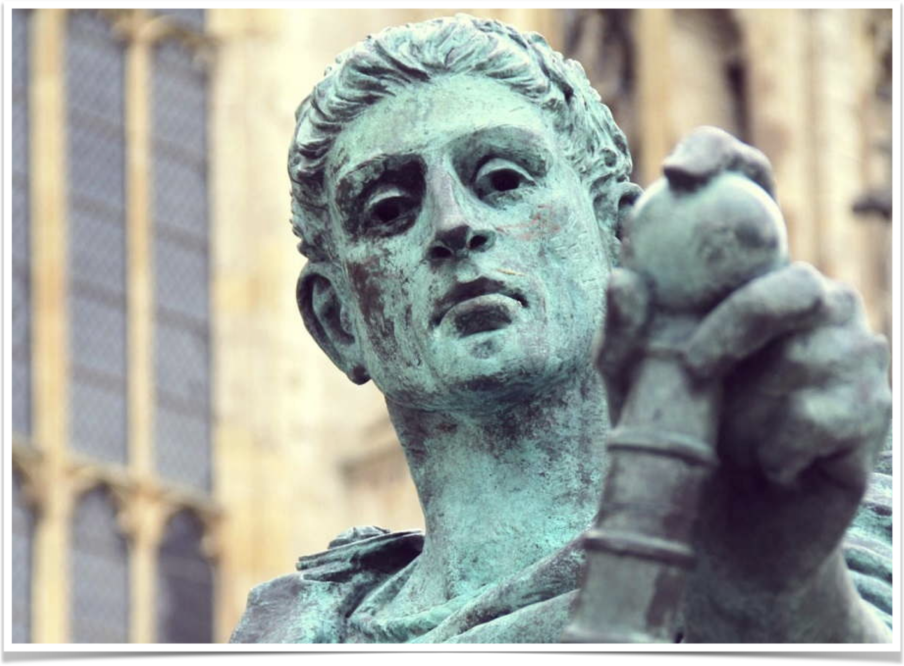
Common figure in prophecy
Babylon – Is. 13:10
Egypt – Ez. 32:7
Tyre, Sidon, Philistia – Joel 3:15
Jerusalem – Mt. 24:29
A great upheaval within the halls of power; it ends with the collapse of a nation
Notes:
Babylon – Isaiah 13:10, “For the stars of heaven and their constellations Will not give their light; The sun will be darkened in its going forth, And the moon will not cause its light to shine.”
Egypt – Ezekiel 32:7, “When I put out your light, I will cover the heavens, and make its stars dark; I will cover the sun with a cloud, And the moon shall not give her light.”
Tyre, Sidon, Philistia – Joel 3:15, “The sun and moon will grow dark, And the stars will diminish their brightness.”
Jerusalem – Matthew 24:29, “Immediately after the tribulation of those days the sun will be darkened, and the moon will not give its light; the stars will fall from heaven, and the powers of the heavens will be shaken.”
A great upheaval within the halls of power; it ends with the collapse of a nation

Slide 12
7 and 7 - verses 12-14
Earth (earthquake) | Kings of the earth
Sun | Great men
Moon | The rich men
Stars | The commanders
Sky | The mighty men
Mountain | Slave
Island | Freeman
Notes:
7 structures of creation thrown into a tumult
Earth (earthquake)
Sun
Moon
Stars
Sky
Mountain
Island
7 classes of men thrown into tumult
Kings of the earth
Great men
The rich men
The commanders
The mighty men
Slave
Freeman
The imagery portends a cataclysmic shift that affected the entire empire from top to bottom

Slide 13
Verses 16-17
“and said to the mountains and rocks, 'Fall on us and hide us from the face of Him who sits on the throne and from the wrath of the Lamb!'”
Hosea 10:8, “Also the high places of Aven, the sin of Israel, Shall be destroyed. The thorn and thistle shall grow on their altars; They shall say to the mountains, ‘Cover us!’ And to the hills, ‘Fall on us!’”
Luke 23:28-30 But Jesus, turning to them, said, "Daughters of Jerusalem, do not weep for Me, but weep for yourselves and for your children. [29] For indeed the days are coming in which they will say, 'Blessed are the barren, wombs that never bore, and breasts which never nursed!' [30] Then they will begin 'TO SAY TO THE MOUNTAINS, "FALL ON US!" AND TO THE HILLS, "COVER US!" '
Notes:
“and said to the mountains and rocks, 'Fall on us and hide us from the face of Him who sits on the throne and from the wrath of the Lamb!’”
Hosea 10:8, “Also the high places of Aven, the sin of Israel, Shall be destroyed. The thorn and thistle shall grow on their altars; They shall say to the mountains, ‘Cover us!’ And to the hills, ‘Fall on us!’”
Luke 23:28-30 But Jesus, turning to them, said, "Daughters of Jerusalem, do not weep for Me, but weep for yourselves and for your children. [29] For indeed the days are coming in which they will say, 'Blessed are the barren, wombs that never bore, and breasts which never nursed!' [30] Then they will begin 'TO SAY TO THE MOUNTAINS, "FALL ON US!" AND TO THE HILLS, "COVER US!" '
A figurative depiction of people fleeing from the judgment of God.

Slide 14
What it means
Efforts to stamp out Christianity failed
305-323: struggle for throne won by Constantine
325 - The Council of Nicaea
330 - moved the capitol to Constantinople
Notes:
Efforts to stamp out Christianity failed
303 - Galerius and Diocletian instigated a persecution of the church.
Although the persecution was intense and some recanted, many Christians stood firm.
Over time, the Roman population began to sympathize and show solidarity with their Christian neighbors.
311 - After eight years of fruitless efforts, Galerius, as he was dying, sought to “make his peace with the undefeated God of the Christians, promulgated an edict of toleration, recognizing Christianity as a lawful religion and asking the prayers of the Christians” (Durant, Caesar and Christ, p. 652).
“The Diocletian persecution was the greatest test and triumph of the Church…There is no greater drama in human record than the sight of a few Christians, scorned or oppressed by a succession of emperors, bearing all trials with a fierce tenacity, multiplying quietly, building order while their enemies generated chaos, fighting the sword with the word, brutality with hope, and. at last defeating the strongest state that history bas known. Caesar and Christ had met in the arena, and Christ had won” (Durant, Caesar and Christ, p. 652).
305-323: struggle for throne won by Constantine
305 - Diocletian abdicated the throne and sets off a nearly 20 year struggle for supremacy
October 27, 312 - Constantine meets Maxentius in battle at Red Rocks
Supposedly sees a sign in the air, hears the words, “In this sign conquer” – the sign was a cross
Constantine won the battle
Became the first “Christian” statesman
Mother was reputedly a follower of the Lord – whether legitimate or apostate is uncertain.
Constantine had seen three unsuccessful persecutions of Christianity that led to its growth.
He was impressed with the order, morality, submission, and conduct of Christianity
As his power grew, he favored Christians more and more
Land owned by churches was not taxed
Congregations supported out of the government treasury
Built meetinghouses
325 - The Council of Nicaea
Constantine convened this council to settle a dispute over the nature of Jesus raised by Arius
He contended that Jesus was a created being and not of the same substance as God the Father.
The council ruled against Arius and declared his teaching heretical
330 - moved the capitol to Constantinople

Slide 15
“The Council (of Nicaea)...marked the replacement of paganism with Christianity as the religious expression and support of the Roman Empire, and committed Constantine to a more definite alliance with Christianity than ever before. A new civilization, based on a new religion, would now rise over the ruins of an exhausted culture and a dying creed. The Middle Ages had begun.”
–Durant, Caesar and Christ
Notes:
The sixth seal represents the formation of an entirely new Roman empire: under Constantine, all levels of government were changed, power was restructured, civil law was redefined, the capital was moved, and the religion of the state was changed.

Slide 16
“The ruin of the Pagan religion is described by the sophists as a dreadful and amazing prodigy, which covered the earth with darkness, and restored the ancient dominion of chaos and of night.”
–Gibbon, The Decline and Fall of the Roman Empire
Notes:
Remember verses 16-17, “and (they) said to the mountains and rocks, "Fall on us and hide us from the face of Him who sits on the throne and from the wrath of the Lamb! For the great day of His wrath has come, and who is able to stand?"” (Revelation 6:16-17)
Imagine if, in five years, the United States declared Islam the state religion.
Every citizen was urged to convert to Islam.
Sharia law was instituted.
Churches and synagogues were closed, and mosques were built by the government across the US.
How might most of us feel?

Slide 17
Seal #6, Part 2
Notes:
Read 7:1-8

Slide 18
Seal #6, Part 2 - What John sees
“after these things” - at the conclusion of the preceding events
“four” - the number of the earth
“four corners” - universality, the complete planet (i.e. four directions)
“four winds” - destructive forces
Fifth angel with “the seal of the living God”
Notes:
“after these things” - at the conclusion of the preceding events
“four” - the number of the earth
“four corners” - universality, the complete planet (i.e. four directions)
“four winds” - destructive forces
Fifth angel with “the seal of the living God”
Seal denotes an open profession of ownership, identification, genuineness, authenticity
Separation of believers from unbelievers

Slide 19
Who was sealed?
12 tribes of 12,000 or 144,000
“of the children of Israel” - spiritual Israel (verse 3, “the servants of our God”)
“who were sealed” - sealed with their Father's name (see 14:1) on their forehead (v. 3)
Dan and Ephraim excluded
144,000: those who keep themselves free from apostasy during the time of the trumpets
Notes:
12 tribes and 144,000 sealed
12 = governmental perfection to the Jews (12 tribes, twelve apostles, 3 times 4)
144,000 = a definite number that represents an indefinite number of faithful to the Lord.
“of the children of Israel” - Spiritual Israel, the faithful of God (see verse 3, “the servants of our God”)
“who were sealed”:
sealed with their Father's name (see Revelation 14:1, “Then I looked, and behold, a Lamb standing on Mount Zion, and with Him one hundred and forty-four thousand, having His Father's name written on their foreheads.”
Sealed on their forehead (v. 3)
Dan and Ephraim left out of the numbering
Dan: the first tribe that went into idolatry (Judges 18)
Ephraim: the primary promoter of idolatry
Joseph and Levi were included as a result

Slide 20
Ezekiel 9
“six men”: parallel to the four angels in Rev. 7:1
Northern gate: Babylonian army would come from the north against Jerusalem
“one man [with] a writer’s inkhorn”: parallel to the fifth angel in Rev. 7:2
Ezekiel 9:4, “Go through the midst of the city, through the midst of Jerusalem, and put a mark on the foreheads of the men who sigh and cry over all the abominations that are done within it."
God sees and claims those who are grieved by apostasy
Notes:
Paralleled by Ezekiel 9 – the marking of God’s people in Jerusalem
“six men”: parallel to the four angels in Rev. 7:1
Northern gate: Babylonian army would come from the north against Jerusalem
“one man [with] a writer’s inkhorn”: parallel to the fifth angel in Rev. 7:2
Ezekiel 9:4, “Go through the midst of the city, through the midst of Jerusalem, and put a mark on the foreheads of the men who sigh and cry over all the abominations that are done within it."
Jerusalem was consumed by idolatry, some people were disturbed by the idolatry, God would destroy the city, but He marked those faithful who mourned the state of affairs.
God sees and claims those who are grieved by apostasy

Slide 21
Verses 9-12
“a great multitude which no one could number” - all the faithful throughout all ages
  Identified in verse 14: those “who come out of the great tribulation”
  2 Timothy 3:12, “Yes, and all who desire to live godly in Christ Jesus will suffer persecution."
“nations, tribes, peoples, and tongues” - from all over the world
“palm branches”- a symbol of victory
“Blessing…glory…wisdom…thanksgiving…honor…power…might”
  A seven-fold praise of God (seven is the number of perfection or completeness)
Notes:
Read 7:9-12
“a great multitude which no one could number” - identified in verse 14.
Those who come out of the great tribulation
2 Timothy 3:12, “Yes, and all who desire to live godly in Christ Jesus will suffer persecution."
“nations, tribes, peoples, and tongues” - all the faithful throughout all ages
“palm branches”- a symbol of victory
“Blessing…glory…wisdom…thanksgiving…honor…power…might”: seven-fold praise of God.

Slide 22
“the ones who come out of the great tribulation”
They “washed their robes and made them white in the blood of the Lamb”
They “are before the throne of God and serve Him day and night in His temple”
“He who sits on the throne will dwell among them.”
They “shall neither hunger anymore nor thirst anymore,”
Notes:
Read 7:13-17
“These are the ones who come out of the great tribulation”
God has separated His people from the rest of humanity; they are not the recipients of the judgment in either the seals or in the ensuing trumpets.
Even though Constantine “Christianized” Rome, it was an apostate church that rose to power and suppressed the true church (we will learn about this more in chapters 12-14).
They “washed their robes and made them white in the blood of the Lamb”
They “are before the throne of God and serve Him day and night in His temple”
“He who sits on the throne will dwell among them.”
They “shall neither hunger anymore nor thirst anymore,”

Slide 23
“the ones who come out of the great tribulation”
The “sun shall not strike them, nor any heat”
The Lamb “will shepherd them and lead them to living fountains of waters”
“And God will wipe away every tear from their eyes.”
Verses 14-17: a seven-fold assurance to the faithful
Revelation is a book of comfort for anyone who puts their confidence of the Lord, no matter their place in history.
Notes:
The “sun shall not strike them, nor any heat”
The Lamb “will shepherd them and lead them to living fountains of waters”
“And God will wipe away every tear from their eyes.”
Verses 14-17: a seven-fold assurance to the faithful
Revelation is a book of comfort for anyone who puts their confidence of the Lord, no matter their place in history.

Slide 24
“Only let your conduct be worthy of the gospel of Christ, so that whether I come and see you or am absent, I may hear of your affairs, that you stand fast in one spirit, with one mind striving together for the faith of the gospel, and not in any way terrified by your adversaries, which is to them a proof of perdition, but to you of salvation, and that from God. For to you it has been granted on behalf of Christ, not only to believe in Him, but also to suffer for His sake…”
–Philippians 1:27-29

